Slide 1
Plan for the day
Review
Public transportation
Why do so few people use public transportation?
What could we do to encourage additional transit use?
Should we subsidize transit fares?
Should we build subways, light rail, or busses?
Course Review

Slide 2
Review questions
What is the worst case outcome for autonomous vehicles?
What is the best case outcome for autonomous vehicles

Slide 3
Public Transportation

Slide 4
Very few commuters use public transportation
Country | Mass Transit | Drive
Canada | 12% | 74%
USA | 5% | 88%

Slide 5
In US and CA, which cities have highest transit share?
City | MSA Share Mass Transit | City Proper Share Mass Transit
1.
2.
3.
4.
5.
6.
7.
8.
9.
10.
11.
12.
Notes:
NYC: 30%
Toronto 23%
Montreal 22.2%
Ottawa 20%
Vancouver 18%
San Francisco 15%
DC 14%
Winnipeg 13%
Halifax 12%
Boston 12%
Chicago 11%
Quebec City 11%
Edmonton 11%
Victoria 11%

Slide 6
Even in big cities, few people use mass transit
City | MSA Share Mass Transit | City Proper Share Mass Transit
New York City | 30% | 57%
Toronto | 23%
Montreal | 22.2%
Ottawa | 20%
Vancouver | 18%
San Francisco | 15%
DC | 14%
Winnipeg | 13%
Halifax | 12%
Boston | 12%
Chicago | 11% | 25%
Quebec City | 11%

Slide 7
Why do so few commuters use mass transit?
Notes:
We talked about things that would effect choice two weeks ago, access time, travel time, comfort, dollar cost. Let’s just focus on travel time costs

Slide 8
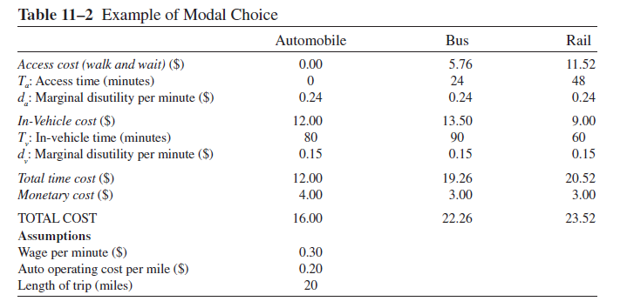
Because it costs more!
Notes:
Monetary cost: fuel and wear and tear, vs cost of fare

Slide 9
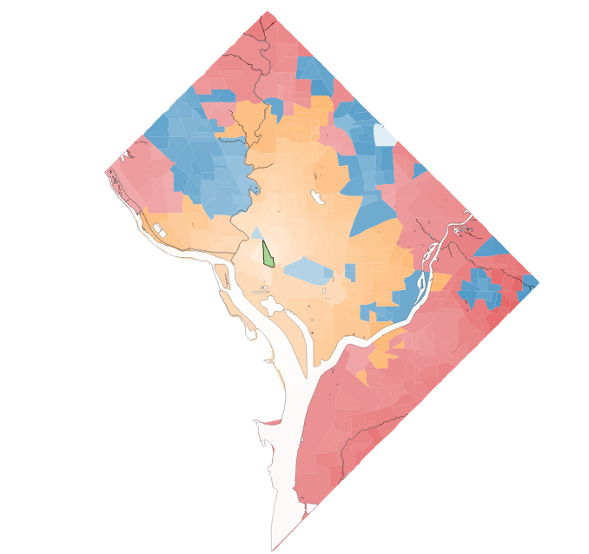
Best way to get around DC from DuPont Circle
Walk: 0.2% (#65C81E)
Bike: 36.9% (#F5C73C)
Transit: 19.2% (#4384C4)
Drive: 43.7%(#D04F46)
Notes:
Includes time for parking car and walking, but doesn’t include monetary costs.
This doesn’t include suburbs --- driving would win even more

Slide 10
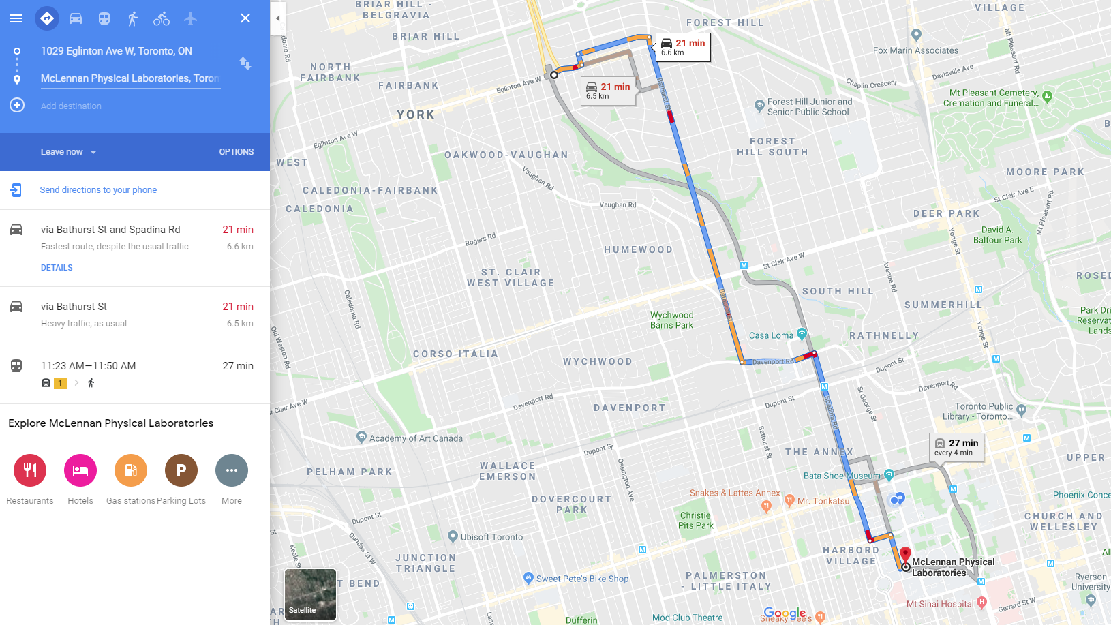
Transit vs driving in Toronto
Notes:
Start from right next to subway
Doesn’t include parking time but also not waiting time for subway (so low in Toronto)
TTC is 29% longer

Slide 11
How do you get more people to ride transit?
Notes:
How would you get people onto transit?
Tipping the balance in favor of transit
Lower income: Lower opportunity cost of travel time
Improved transit service: Decrease access & in-vehicle time cost
If you can get access times down enough, than people will switch
Problem: Should bus stop every block (lower access time, but increase travel time)
Free transit? – not enough to lead many people to switch
Parking cost ($15 full cost for central city parking) – would switch
Internalize automobile externalities: $0.145 per mile for peak period – wouldn’t close gap completely, but gets you closer

Slide 12
Should we subsidize public transit?
In 2018 TTC received $584 million from city --- about $1.08/ride
Our subsidy is relatively low
LA receives 3 USD per ride
NYC receives ~1.50 USD per ride
TTC fares cover 73% of operating costs
NYC covers 47%
MTR (Hong Kong) covers 124%

Slide 13
Should we subsidize public transit?
Notes:
Transit has economics of scale, so - always have falling marginal cost
Why?
Spread out fixed costs over more users - especially for trains and subways
Mohring economies
More riders mean more frequent busses, mean lower access times, mean more riders
Can include all sorts of other costs, but the idea still holds
More riders means longer boarding times, mean more stops (if don't automatically stop everywhere)
What does economies of scale mean for pricing
To balance the budget need to charge at average cost, but socially optimal to charge marginal cost, this means we should have a subsidy
Figure: Download sloping demand, and downward sloping average cost. Marginal cost downward sloping, and below average cost. Optimal to charge marginal cost, but this requires a subsidy
Other arguments for transit subsidies
Roads are underpriced, so we must underprice transit too
Less pollution (including construction costs?)
Reduced accidents
If you account for all of this (and crowding costs, benefits on traffic congestion, scale economies, Mohring economies… you can justify about a 50% subsidy at peak and a 80% subsidy off-peak
OPERATING COST SUBSIDY
Not a construction subsidy
They actually find that you shouldn't build more trains, but once you have them, use them

Slide 14
Bus vs. rail
Notes:
Light rail is more costly than bus system
Higher capital cost: 5x cost ($881m vs. $168m in Long Beach)
Higher operating cost: $0.38 (Portland's MAX) > $0.35 for bus
Diverts bus passengers: 63% of LA Blue Line former bus riders
Feeder buses impose access costs on riders
Bus is flexible
Pro's for light rail
Commitment, can't change it
Bias against busses - busses are for poor people
Smoother ride?
Less worry about where the train will go
People like trains better

Slide 15
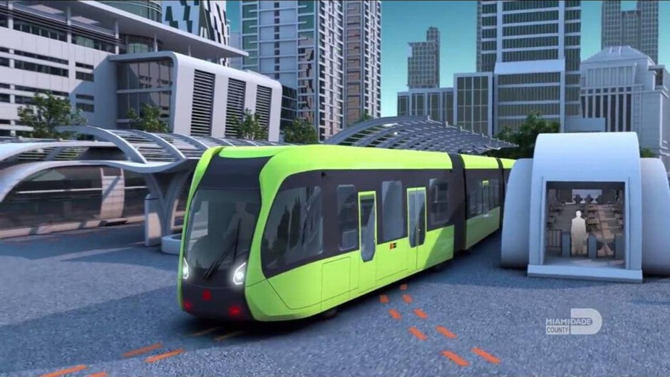
What is a possible solution? Trackless trams!
Notes:
An high tech electric bus, but don’t tell anyone
It is bus rapid transit

Slide 16
Why does it cost so much to build transit in Canada and USA?
It is really expensive to build transit in North America
Toronto-York-Spadina Extension: $3.184 billion for 8.6 km and 6 stations
Ontario Line: $10.9 billion for 15.5 km and 15 stations
Scarborough: 3.48 billion for 6.2 km and 1 station
But other countries build for much less
Median cost: <$300 million per kilometer (Paris)
Stockholm, Seoul, and Madrid: $100—150 million per kilometer
Notes:
Ontario line is not all underground
Canadian costs were not always especially high by world standards
Sheppard subway was completed in 2002 for about $166-million a kilometre.
Montreal
Laval Metro extension cost $143-million a kilometre in 2007
recent Blue Line extension plan is projected to cost $775-million.
Vancouver
mostly underground Canada Line, completed in 2009, cost only $106-million a kilometre
Broadway Skytrain (all underground) almost 500 million per kilometer

Slide 17
Why does it cost so much to build transit in Canada and USA?
We don’t know for sure
Hypotheses
Over build: Stations way bigger/fancier
Too many workers: 4x what is used on similar jobs in Asia, Australia, and Europe
Procurement methods
Politics: Add other costs to transit project. Street reconstruction etc.
Notes:
Note this isn’t about unions, powerful unions in other countries. But the union rules we have are a problem.
We could build more transit if we could build it for less.
https://www.citylab.com/transportation/2018/01/why-its-so-expensive-to-build-urban-rail-in-the-us/551408/
https://pedestrianobservations.com/2019/03/03/why-american-costs-are-so-high-work-in-progress/

Slide 18
Course review
Notes:
a.k.a., what did we do all semester
a.k.a., what do I hope you remember in 5/10 years

Slide 19
Why do cities exist?
Notes:
Cities are terrible
Polluted
Congested
Expensive
Crime
But allow us to co-operate with each other
Economies of scale
Agglomeration

Slide 20
How do we define cities?
Notes:
Lots of people close together

Slide 21
Why do firms cluster? What explains large cities?
Notes:
Agglomeration economies
- Sharing
- Matching
- Learning

Slide 22
Are cities too big or too small?
Notes:
Too big: Not stable to have cities too small

Slide 23
Why are cities different sizes?
Notes:
Different natural endowments
Different industries -> different scale for their agglomeration economies
Differences in fundamentals multiplied due to local jobs

Slide 24
Why is housing (per sq ft) cheaper in the suburbs?
Notes:
Compensating differential for higher commuting costs

Slide 25
Why are homes smaller downtown?
Notes:
Higher price per sq ft -> substitute away from housing towards other goods

Slide 26
Why are buildings taller downtown?
Notes:
two ways of explaining
P(x) higher downtown
So for any given building height profits are higher,
So land rents higher
So developers substitute relatively cheap capital for relatively expensive land

Slide 27
Monocentric city model helps explain differences
Within a city
Across cities
Also highlights role of transportation costs in city form

Slide 28
What is urban sprawl?
Notes:
Version 1: Cities are too big and take up too much land.
Version 2: Cities are inefficiently too big

Slide 29
What causes socially inefficient urban sprawl?
Notes:
Challenges in bundling land
Financing of infrastructure
Underpriced roads
Open space as a public good
Zoning (can be driven by desire to avoid living near minorities and poor)

Slide 30
How do we avoid inefficient urban sprawl?
Notes:
Congestion charge
Development tax
Urban growth boundary

Slide 31
What are the problems with rent control?
Notes:
Inadequate maintenance - "you get what you pay for"
Less new construction - even if exempt, due to possibility of future taking
Its benefits are not means tested
Discrimination
Misallocation of housing
Both because people never leave
And in initial assignment

Slide 32
Why is rent control popular?
Notes:
Its effects are immediate (especially relative to growth in supply)
It is widespread---operates at scale
It is off-budget, so "no" tax revenue required (of course, it can effect tax revenue through other changes)
Favors incumbent renters (i.e., current voters)
Has populist appeal---landlords are not a sympathetic class (especially relative to renters)

Slide 33
How can you reduce problems from rent control?
Notes:
All prices to be set by the market between tenants

Slide 34
Should you buy or rent?
It depends!

Slide 35
How do we know there is too much traffic congestion?
Notes:
Externality, you slow down other drivers

Slide 36
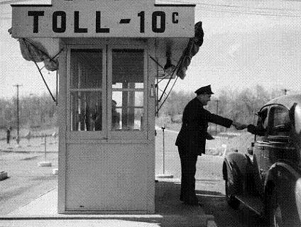
What do economists want to do about it?
Notes:
Add tolls – ideal toll is paid electronically, time varying,

Slide 37
How do you add tolls so that drivers like them?
Notes:
Add tolls to just some lanes
Set tolls to increase capacity
Key idea: preserve ability of poor to pay with time instead of money

Slide 38
What are other solutions to congestion?
Raise cost of parking
Gas tax
Vehicle kilometers traveled tax
Sales tax
Driving restrictions
And more
Notes:
None hit all the choices an optimal congestion charge would hit, but have the benefit of (usually) being easier to implement

Slide 39
Will autonomous vehicles make things better?
Notes:
Maybe, could also make things worse
Great time to implement congestion charge

Slide 40
Why do so few people ride transit?
Notes:
Because it is slower, worse than driving

Slide 41
What kind of transit should we build?
Notes:
Typically bus

Slide 42
Should we subsidize transit fares?
Notes:
Yes, economies of scale

Slide 43
Thank you

